Slide 1


Sales Performance Analysis of High Impact Careers
This presentation explores the sales performance of High Impact Careers. It covers data cleaning, analysis, and visualization, culminating in actionable insights and recommendations.
by Oluwatosin Giwa

Slide 2
Data Preparation and Cleaning
Initial Data Examination
Data Cleaning in Excel
The dataset, an Excel file with 34,867 rows and 15 columns, contained information on order ID, date, customer details, salesperson, branch, product category, and sales metrics.
The initial step involved standardizing date formats, renaming and ordering headers, and correcting data types to ensure data consistency and clarity.

Slide 3

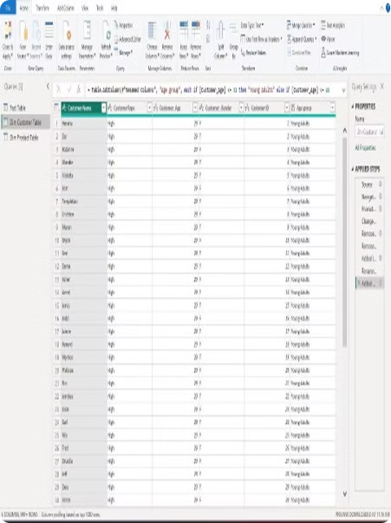
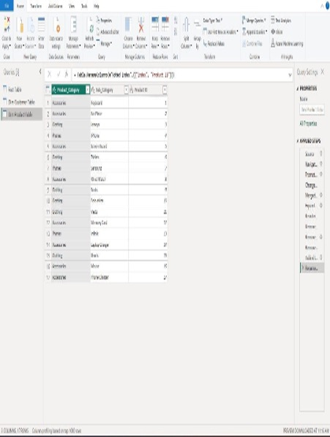
Creating Dimension Tables
Customer Table
This table contained customer name, type, age, and gender, with unique IDs created to link it to the fact table.
Product Table
This table included product ID, category, and subcategory, also with unique IDs for linking.

Slide 4
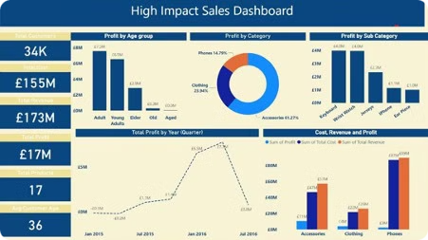



Data Analysis and Visualization in Power BI
Key Performance Indicators (KPIs)
Detailed Insights
Power BI enabled the calculation and visualization of KPIs such as total customers, product costs, revenue, profits, quantity sold, and average customer age.
Analysis focused on profit by age group, product category, and subcategory, as well as annual and quarterly profit trends and salesperson performance.

Slide 5
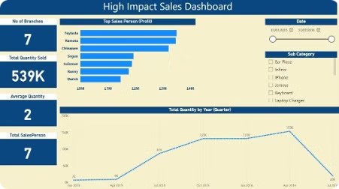

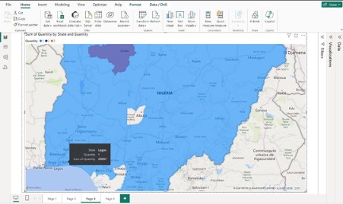
Interactive Filtering
1
Date
Users could filter data by specific dates, years, and months to analyze trends over time.
2
Product Subcategory
Interactive filters allowed users to drill down into specific product subcategories to understand their performance.

Slide 6





Recommendations
Focus on Profitable Age Groups
Marketing efforts should be tailored to the most profitable age groups.
Optimize Product Offerings
Increase inventory and promotional efforts for high-performing product categories and subcategories.
Seasonal Promotions
Leverage insights from quarterly trends to run targeted promotions during peak periods.
Salesperson Training
Implement training programs based on the practices of top-performing salespersons to boost overall sales performance.

Slide 7



Conclusion
Data-Driven Insights
1
The analysis provided a comprehensive understanding of sales dynamics, leading to informed recommendations.
Actionable Recommendations
2
The insights can be used to drive business growth and improve sales performance.
Value of Data Analysis
3
This project underscored the importance of data-driven decision-making in today's business environment.

Slide 8

Next Steps
The next steps involve implementing the recommendations, monitoring the impact on sales performance, and continuously refining the analysis process. This will ensure that High Impact Careers continues to optimize its sales strategies and achieve its business goals.

